Slide 1
Transformations of Stress and Strain Lecture 16
Engineering Mechanics - ME102
Courtesy: TMH

Slide 2
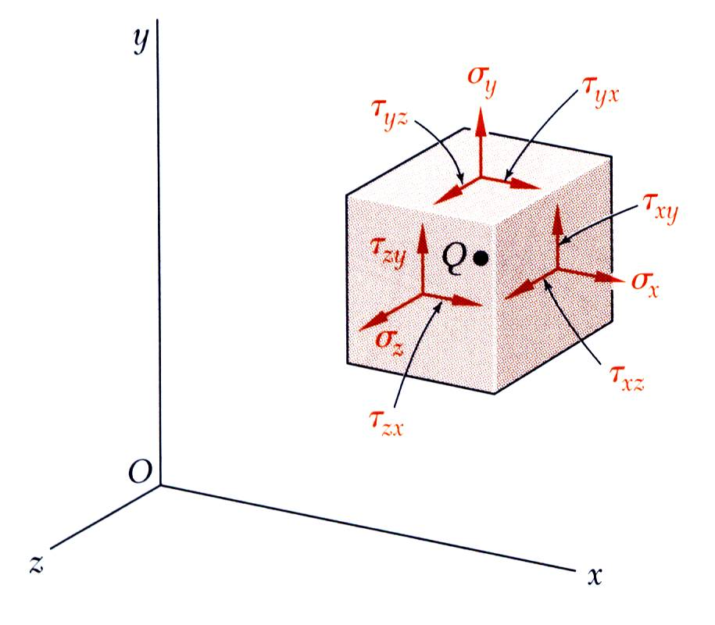
Nomenclature
Note that the first subscript represents the surface on which the force is acting (i.e. surface normal direction), in this case a surface perpendicular to x axis, i.e. the y-z plane
The second subscript refers to the direction of force

Slide 3
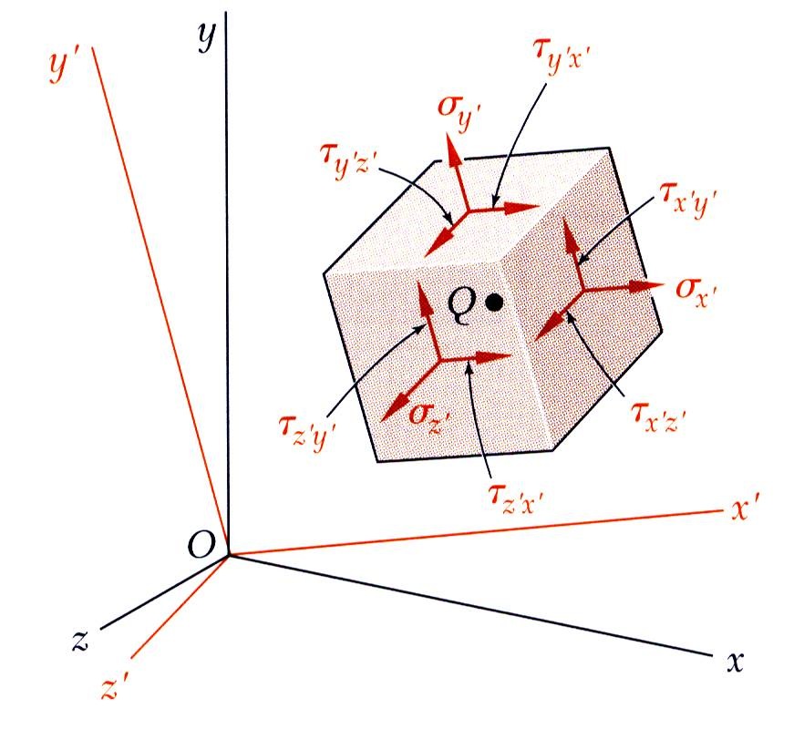
Introduction
The most general state of stress at a point may be represented by 6 components,
Same state of stress is represented by a different set of components if axes are rotated.
The first part of the chapter is concerned with how the components of stress are transformed under a rotation of the coordinate axes. The second part of the chapter is devoted to a similar analysis of the transformation of the components of strain.

Slide 4
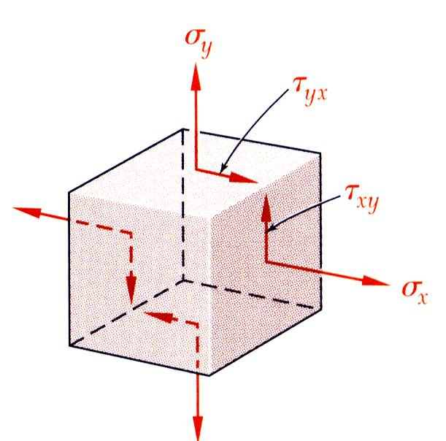
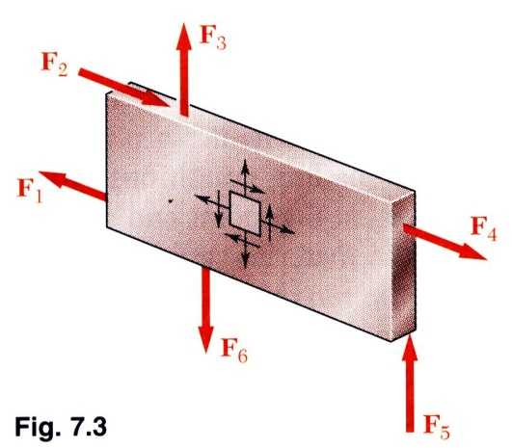
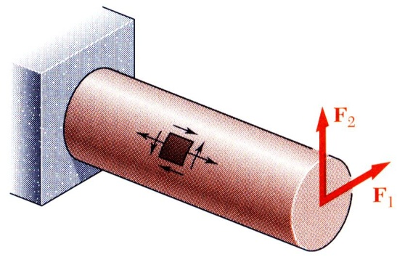
Introduction
Plane Stress - state of stress in which two faces of the cubic element are free of stress. For the illustrated example, the state of stress is defined by
State of plane stress occurs in a thin plate subjected to forces acting in the midplane of the plate.
State of plane stress also occurs on the free surface of a structural element or machine component, i.e., at any point of the surface not subjected to an external force.

Slide 5
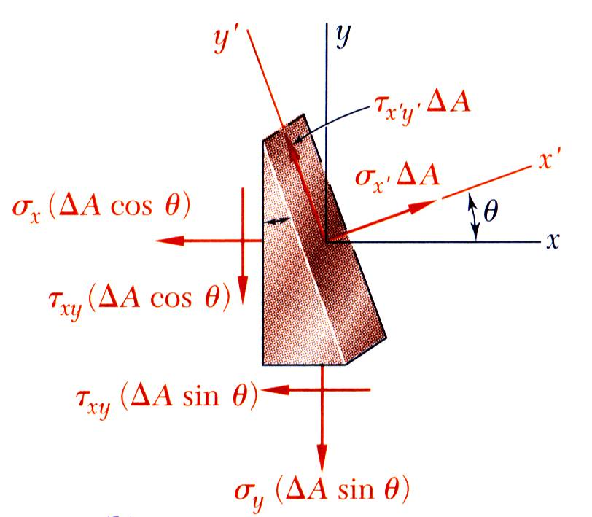

Transformation of Plane Stress
Consider the conditions for equilibrium of a prismatic element with faces perpendicular to the x, y, and x’ axes.
Compare with
The equations may be rewritten to yield
Check $σ_{x′}+σ_{y′}=??$

Slide 6
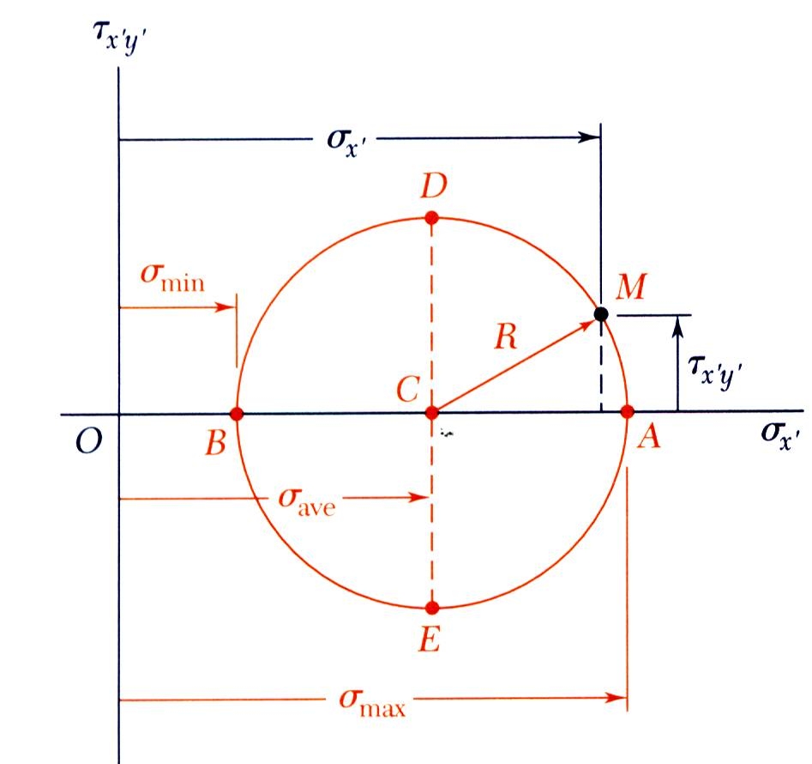
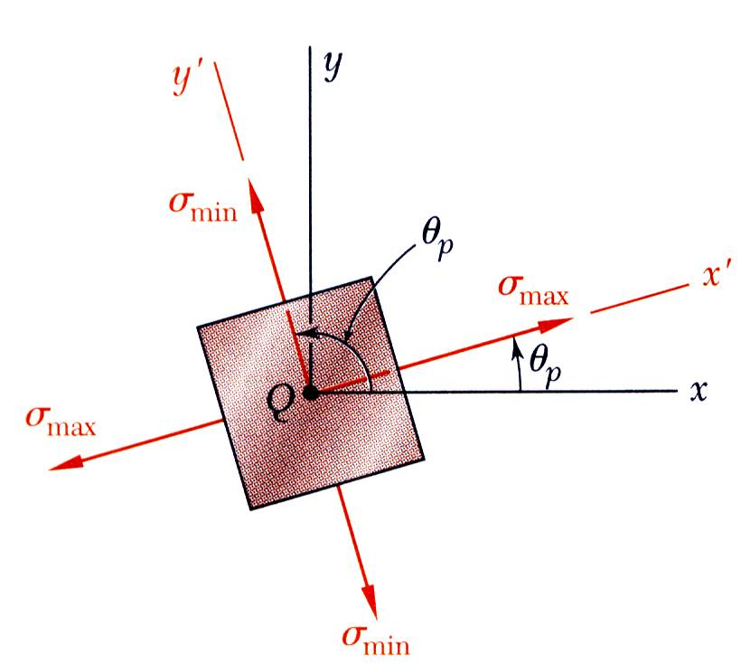

Principal Stresses
The previous equations are combined to yield parametric equations for a circle,
Principal stresses occur on the principal planes of stress with zero shearing stresses.
Note: Circle does not change if you take $−τ_{xy}$

Slide 7
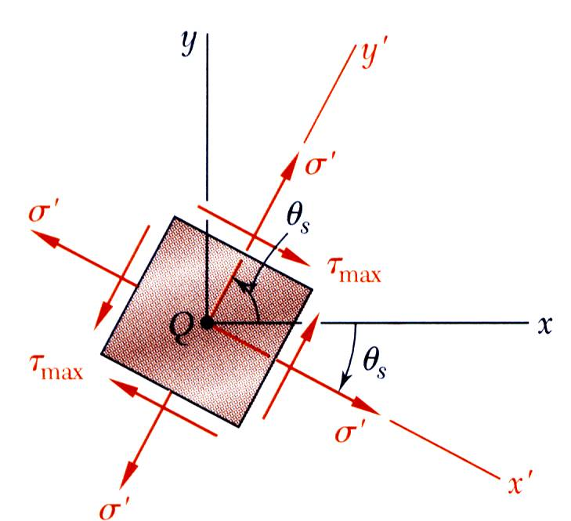
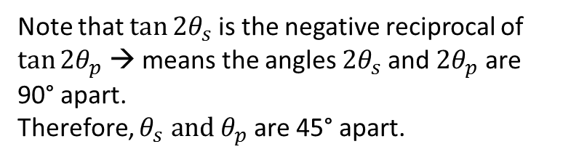
Maximum Shearing Stress
Maximum shearing stress occurs for
Note that $\tan{2θ_{s}}$ is the negative reciprocal of $\tan{2θ_{p}}$ → means the angles ${2θ}_{s}$and ${2θ}_{p}$ are 90° apart.
Therefore, $θ_{s} and θ_{p}$ are 45° apart.

Slide 8
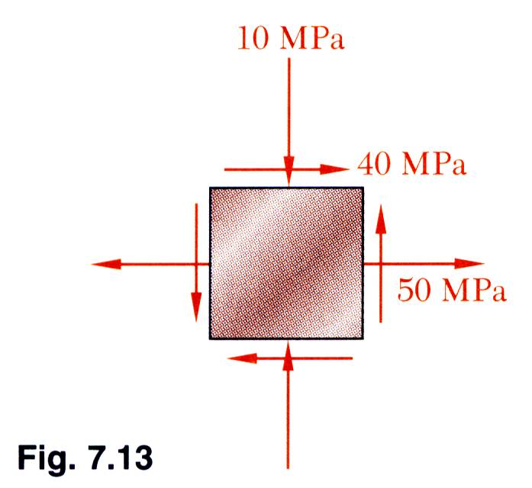
Example 7.01
For the state of plane stress shown, determine (a) the principal planes, (b) the principal stresses, (c) the maximum shearing stress and the corresponding normal stress.

Slide 9
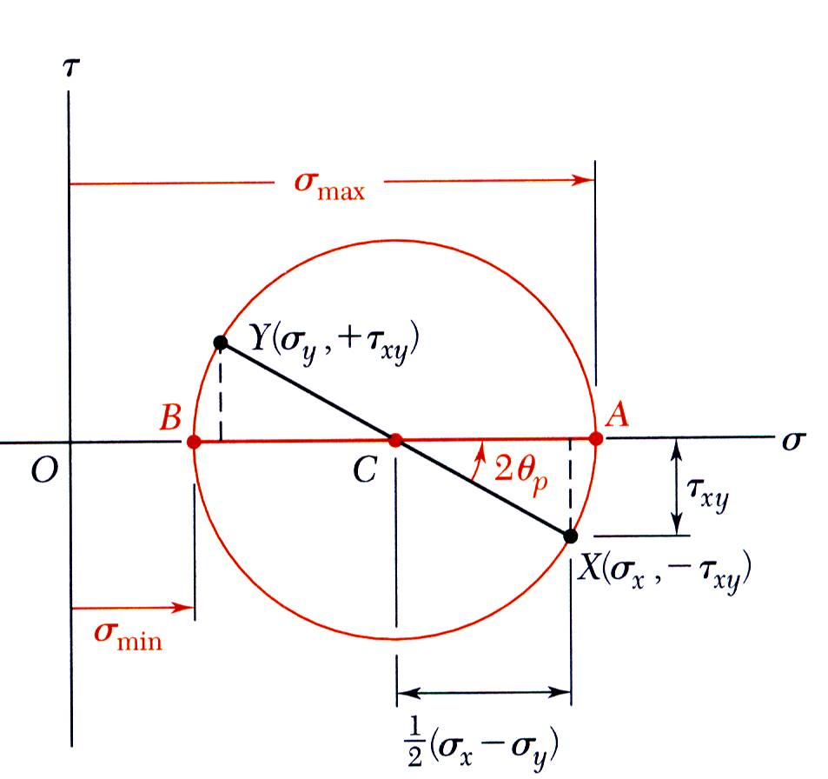
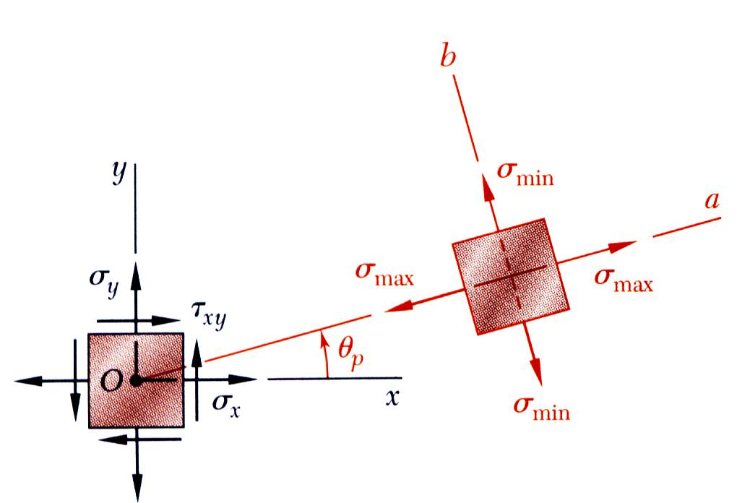
Mohr’s Circle for Plane Stress
With the physical significance of Mohr’s circle for plane stress established, it may be applied with simple geometric considerations. Critical values are estimated graphically or calculated.
For a known state of plane stress plot the points X and Y and construct the circle centered at C.
The principal stresses are obtained at A and B.
The direction of rotation of Ox to Oa is the same as CX to CA.

Slide 10
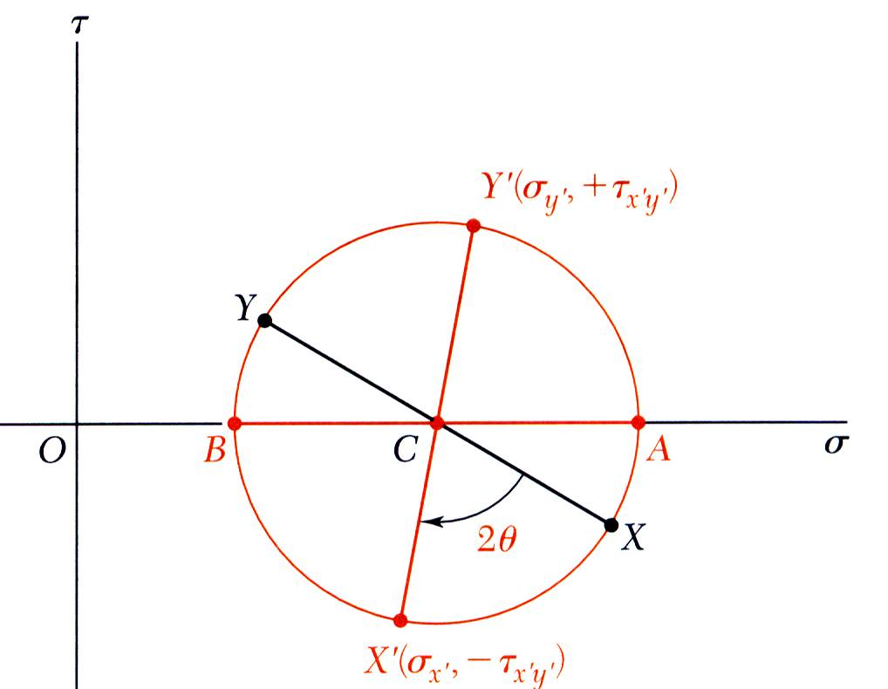
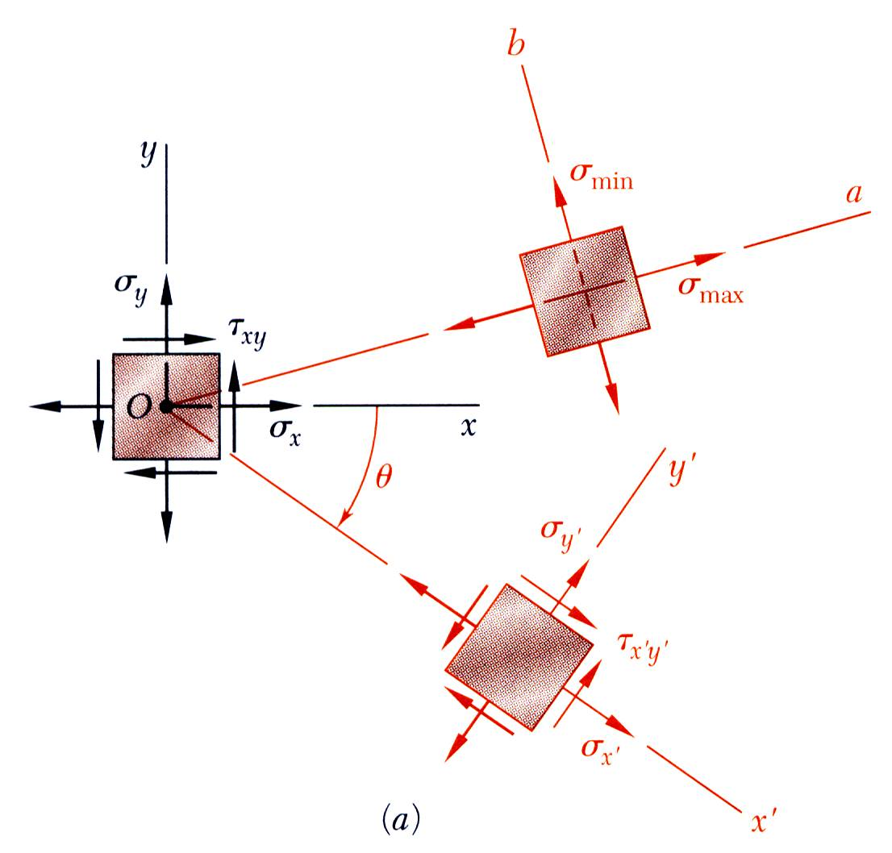
Mohr’s Circle for Plane Stress
With Mohr’s circle uniquely defined, the state of stress at other axes orientations may be depicted.
For the state of stress at an angle θ with respect to the xy axes, construct a new diameter X’Y’ at an angle 2θ with respect to XY.
Normal and shear stresses are obtained from the coordinates X’Y’.

Slide 11
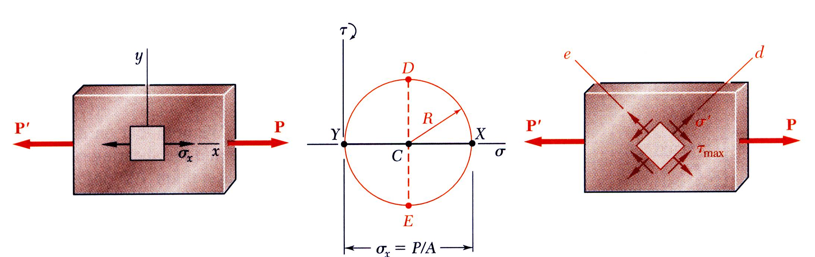
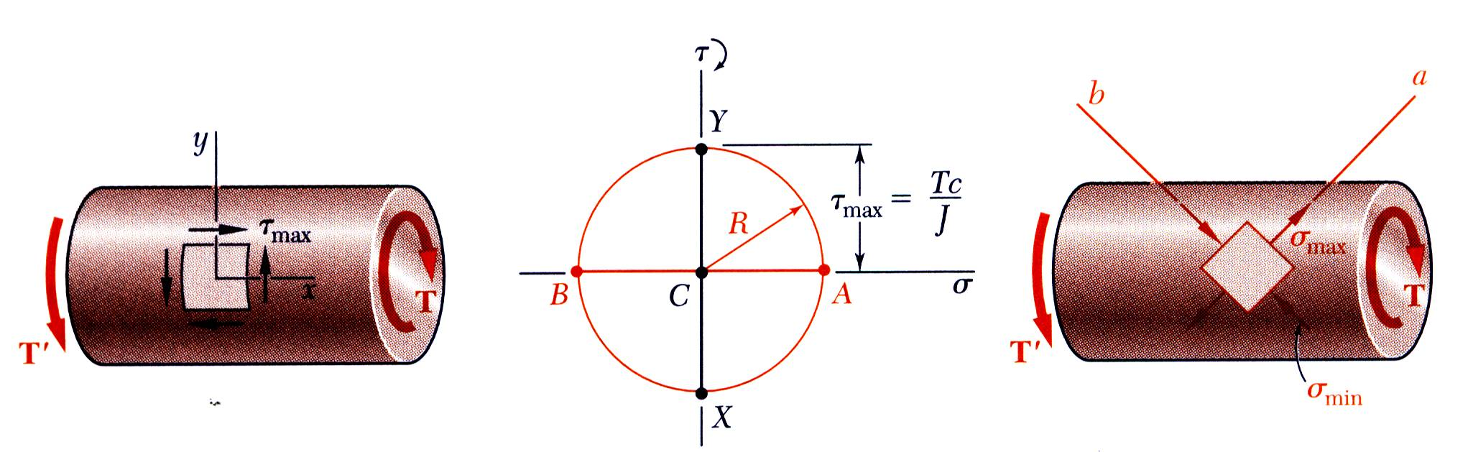
Mohr’s Circle for Plane Stress
Mohr’s circle for centric axial loading:
Mohr’s circle for torsional loading:

Slide 12
Example 7.02
For the state of plane stress shown, (a) construct Mohr’s circle, determine (b) the principal planes, (c) the principal stresses, (d) the maximum shearing stress and the corresponding normal stress.

Slide 13
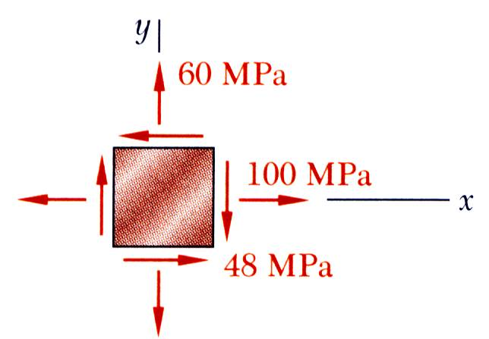
Sample Problem 7.2
For the state of stress shown, determine (a) the principal planes and the principal stresses, (b) the stress components exerted on the element obtained by rotating the given element counterclockwise through 30 degrees.

